Slide 1

Hostel Froodie
ME781 Project
Interim Report

Slide 2

Objective

Slide 3
Objective
We are creating a software that would prepare mess friendly personalized meal plans for the hostel residents based upon their calorie requirements and their preferences. This meal plan would also get updated throughout the day based on the food items user intakes
We further intend to add additional features like preparing meals and activity plans for a targeted bodyweight and fitness level.
In future, we plan to improve the meal suggestions by analyzing how the user responds to the meal plan. We also intend to collect the data from the user to a central system and provide that data to the mess caterers, so that a closed system can be created, and food wastage is minimized.

Slide 4

Problem Definition

Slide 5
Problem Definition
One of the most common problems hostel students face these days is following a meal plan and maintaining a balanced diet. This is a challenge that many students face and as a result of this, they often undergo drastic physical changes in a matter of months. Often, students are unable to comprehend the nutritional value of the food that is available in the mess and end up eating unhealthily.
In lieu of this, we decided to make a smart meal planner that is flexible and caters to the individual as a college student. We take your weekly mess menu as well as your food logs and by running an AI it generates the best course of action for your day.
The available solutions for generating meal plans are based on the fact that the user is free to decide the menu of the week. Our product is customized for the mess users, giving them the much-needed assistance in planning their meals from available options.

Slide 6

Technology Landscape Assessment

Slide 7
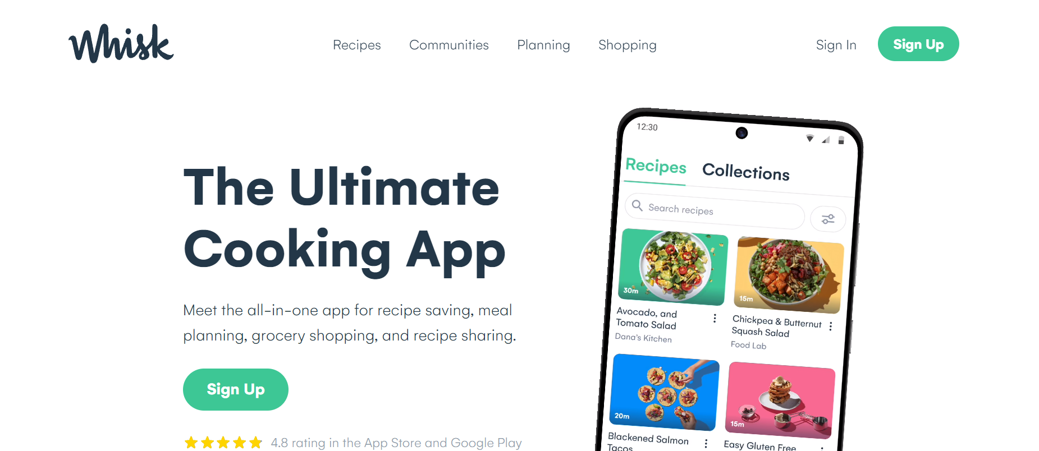
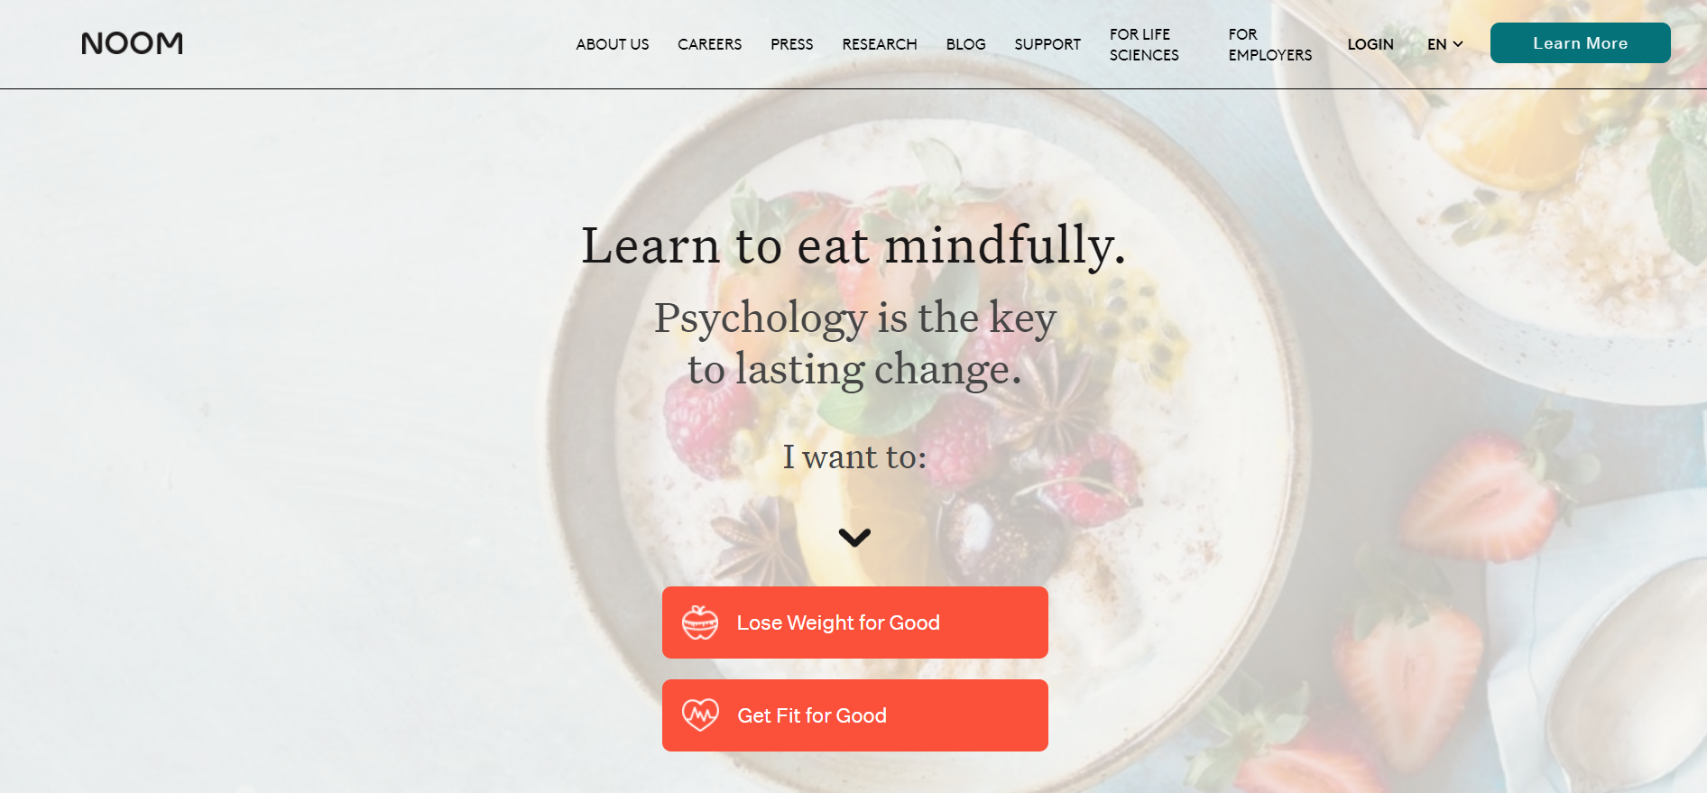
Technology Landscape Assessment
Meal Planning AI Softwares
Recipe AI Softwares
Whisk’s Culinary Coach - AI-powered nutrition platform that provides food recommendations based on flavour preferences and avoidances
Frélii - a health tool that uses AI to build unique nutrition and health needs
Noom – A software that takes the user's exercise and food logs
Spoonshot - AI-based app that suggests recipes based on available ingredients
RecepiBook - uses AI to recommend food recipes based on user behavior and cravings
Gulpie – uses AI to recommend Restaurants and places to eat, to suit the user's diet.

Slide 8

Project Plan

Slide 9
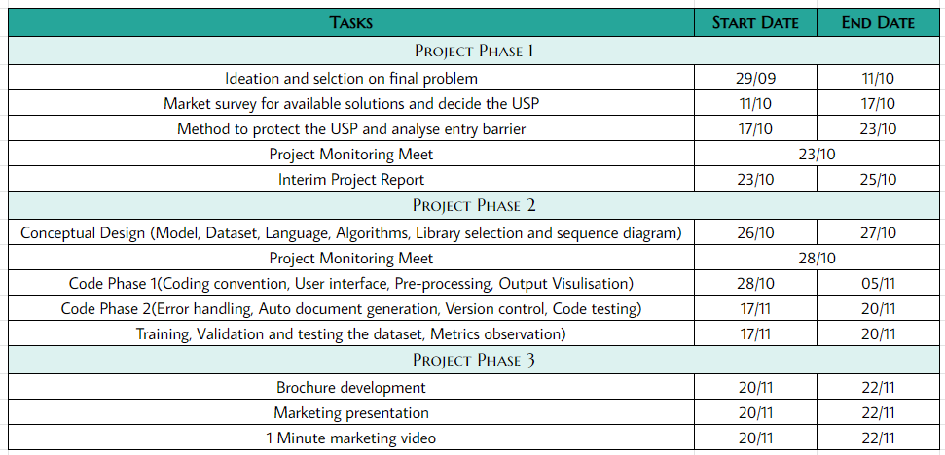
Project Plan

Slide 10
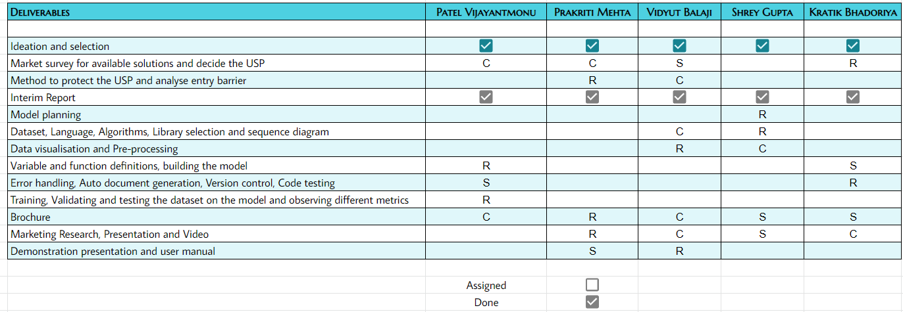
RASIC Chart

Slide 11
Team Members
Patel Vijayantmonu
Prakriti Mehta
Vidyut Balaji
Shrey Gupta
Kratik Bhadoriya

